Slide 1
Data Encryption Standard (DES)
Dr. B C Dhara
Department of Information Technology
Jadavpur University

Slide 2
Objectives
Define the basic structure of DES
Describe the details of building elements of DES
Describe the round keys generation process
Analyze DES
B C Dhara, Dept. of IT, JU

Slide 3
Introduction
The Data Encryption Standard (DES) is a symmetric-key block cipher published by the National Institute of Standards and Technology (NIST).
In 1973, NIST published a request for proposals for a national symmetric-key cryptosystem.
  A proposal from IBM, a modification of a project called Lucifer, was accepted as DES.
  DES was published in the Federal Register in March 1975 as a draft of the Federal Information Processing Standard (FIPS).
B C Dhara, Dept. of IT, JU

Slide 4
Introduction (contd…)
The draft was criticized for:
  Small key length (56 bits), vulnerable to brute-force attack
  Hidden design structure behind the internal structure of DES
DES was finally published as FIPS 46 in the Federal Register in January 1977
  DES as standard for use in unclassified applications
Later a new standard FIPS-3 recommended the use of triple DES
B C Dhara, Dept. of IT, JU

Slide 5


Encryption and decryption with DES
B C Dhara, Dept. of IT, JU

Slide 6
DES structure
Discuss encryption process
  Decryption is in reverse order
The encryption process is made of two permutations (P-boxes), which we call initial and final permutations, and sixteen Feistel rounds
Initial permutation
16 Feistel rounds
Final permutation
B C Dhara, Dept. of IT, JU

Slide 7

General structure of DES
B C Dhara, Dept. of IT, JU

Slide 8

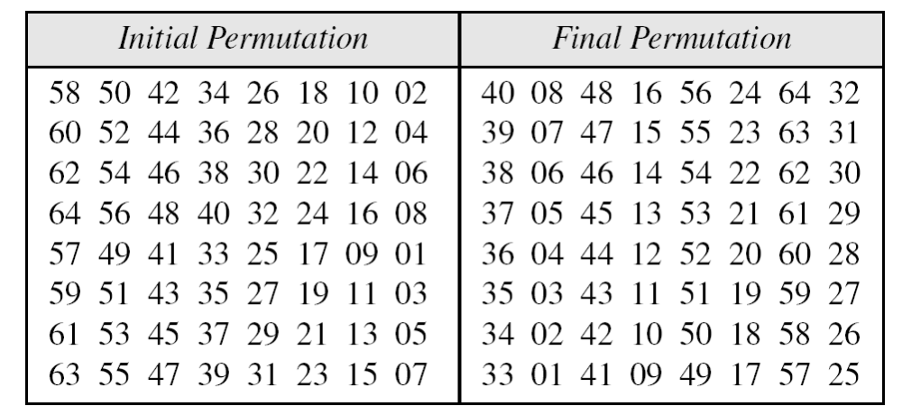
Initial and Final Permutations
B C Dhara, Dept. of IT, JU

Slide 9
Initial and Final Permutations (contd…)
These two permutations (straight P-boxes) have no cryptography significance in DES
Both are keyless, predetermined and inverse of each other
The purpose to include these is not clear
B C Dhara, Dept. of IT, JU

Slide 10

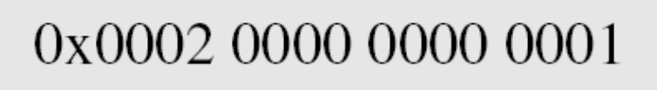
Example: initial permutation
Find the output of the final permutation box when the input is given in hexadecimal as:
Only bit 25 and bit 63 are 1s; the other bits are 0s. In the final permutation, bit 25 becomes bit 64 and bit 63 becomes bit 15. The result is
B C Dhara, Dept. of IT, JU

Slide 11
Example: final permutation
The input has only two 1s; the output must also have only two 1s.
Bit 15 in the input becomes bit 63 in the output.
Bit 64 in the input becomes bit 25 in the output.
B C Dhara, Dept. of IT, JU

Slide 12

Rounds
DES uses 16 rounds. Each round of DES is a Feistel cipher.
B C Dhara, Dept. of IT, JU

Slide 13

DES Function
The heart of DES is the DES function.
The DES function applies a 48-bit key to the rightmost 32 bits to produce a 32-bit output.
B C Dhara, Dept. of IT, JU

Slide 14

Expansion P-box
Since R_{I−1} is a 32-bit input and
K_{I} is a 48-bit key
  we first need to expand R_{I−1} to 48 bits.
B C Dhara, Dept. of IT, JU

Slide 15
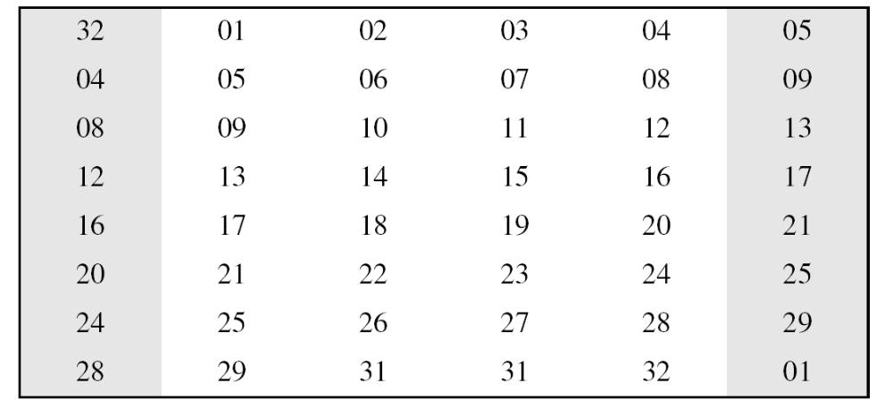
Expansion P-box
This P-box can be defined using a table also
B C Dhara, Dept. of IT, JU

Slide 16
Whitener (XOR)
After the expansion permutation, DES uses the XOR operation on the expanded right section and the round key.
B C Dhara, Dept. of IT, JU

Slide 17

S-boxes
The S-boxes do the real mixing (confusion)
DES uses 8 S-boxes, each with a 6-bit input and a 4-bit output
B C Dhara, Dept. of IT, JU

Slide 18

S-boxes (contd…)
A table with size 4 × 16 with 4-bits value (0-15)
Separate table for different S-boxes
B C Dhara, Dept. of IT, JU

Slide 19

S-boxes (contd…) : S1-box
B C Dhara, Dept. of IT, JU

Slide 20
Example
The input to S-box 1 is 100011. What is the output?
The first and the sixth bits together, we get 11 in binary, which is 3 in decimal.
The remaining bits are 0001 in binary, which is 1 in decimal.
  We look for the value in row 3, column 1, in S-box1
  The result is 12 in decimal, which in binary is 1100. So the input 100011 yields the output 1100.
B C Dhara, Dept. of IT, JU

Slide 21
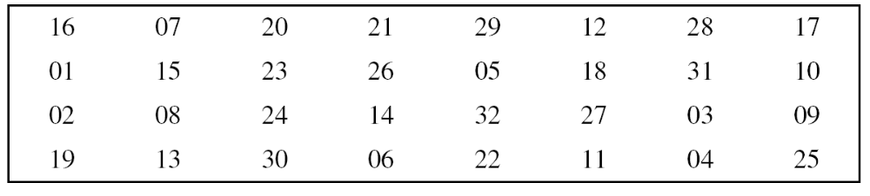
Straight permutation
B C Dhara, Dept. of IT, JU

Slide 22
Rounds
DES uses 16 rounds. Each round of DES is a Feistel cipher.
B C Dhara, Dept. of IT, JU

Slide 23
DES implementation
Using mixers and swappers, the cipher and reverse cipher is created, each having 16 rounds
B C Dhara, Dept. of IT, JU

Slide 24
DES implementation: First approach
This approach is to make the last round (round 16) different from the others; it has only a mixer and no swapper
B C Dhara, Dept. of IT, JU

Slide 25

DES cipher and reverse cipher for the first approach
B C Dhara, Dept. of IT, JU

Slide 26
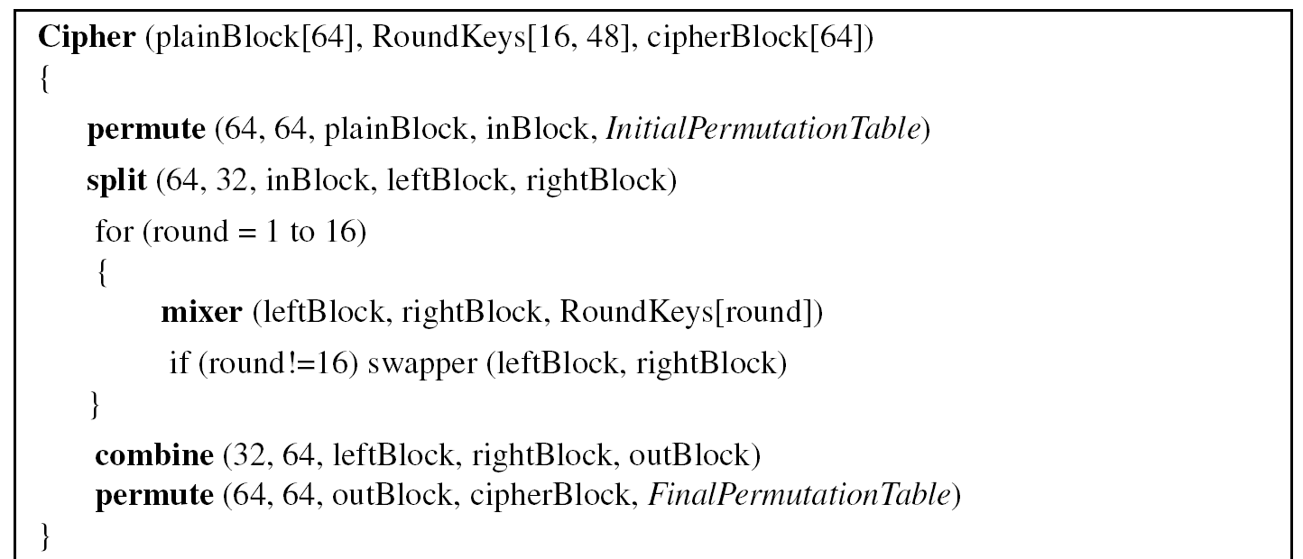
Pseudo code for DES
B C Dhara, Dept. of IT, JU

Slide 27
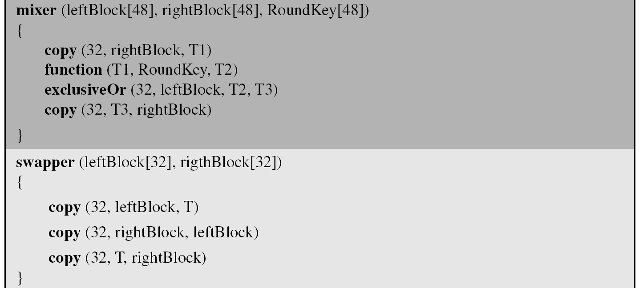
Pseudo code for DES (contd…)
leftBlock
B C Dhara, Dept. of IT, JU

Slide 28
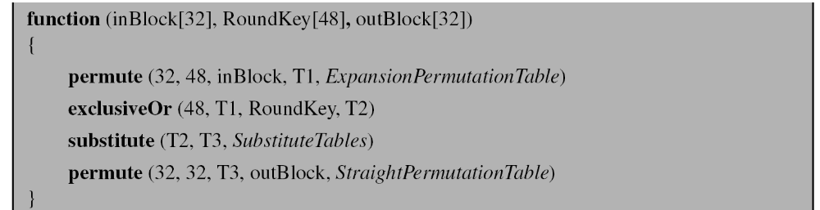
Pseudo code for DES (contd…)
B C Dhara, Dept. of IT, JU

Slide 29
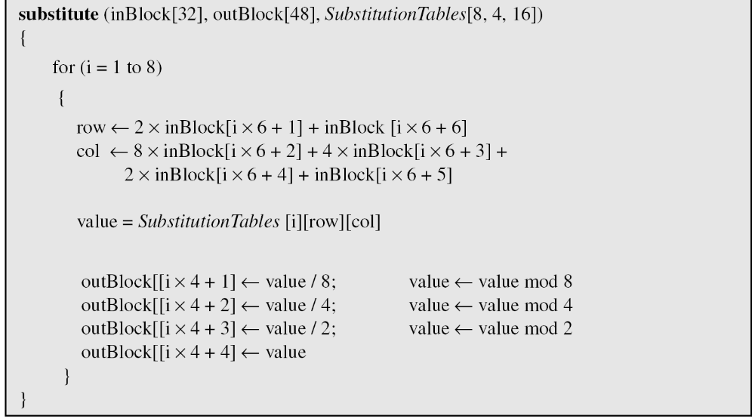
Pseudo code for DES (contd…)
substitute (inBlock[48], outBlock[32], SubstitutionTables[8, 4, 16]
B C Dhara, Dept. of IT, JU

Slide 30
DES implementation: Second approach
We can make all 16 rounds the same by including one swapper to the 16th round and
Add an extra swapper after the 16th round and before the combination
  this will cancel out the effect of the 16th round swapper
Add swapper
B C Dhara, Dept. of IT, JU

Slide 31
Key Generation
The round-key generator creates sixteen 48-bit keys out of a 56-bit cipher key
Normally Cipher key is 64-bit length
8 parity bits [8, 16, 24, 32, …, 64]
Parity bits are dropped and make it 56 bits
Remaining 56 bits are permuted according to the next table
B C Dhara, Dept. of IT, JU

Slide 32

Block diagram of key generation
B C Dhara, Dept. of IT, JU

Slide 33
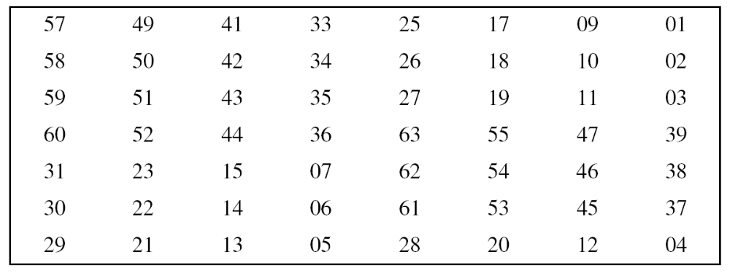
Key Generation (contd…)
Parity-bit drop table
B C Dhara, Dept. of IT, JU

Slide 34
Key Generation (contd…)
Number of bits shifts
B C Dhara, Dept. of IT, JU

Slide 35
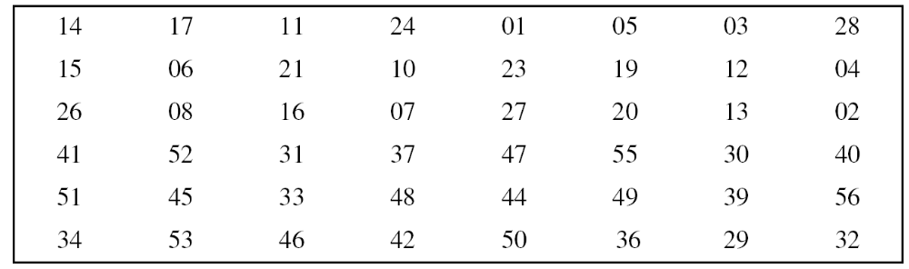
Key Generation (contd…)
Key-compression table
Dropped bits: 7, 9, 18, 22, 25, 38, 43, 54
B C Dhara, Dept. of IT, JU

Slide 36
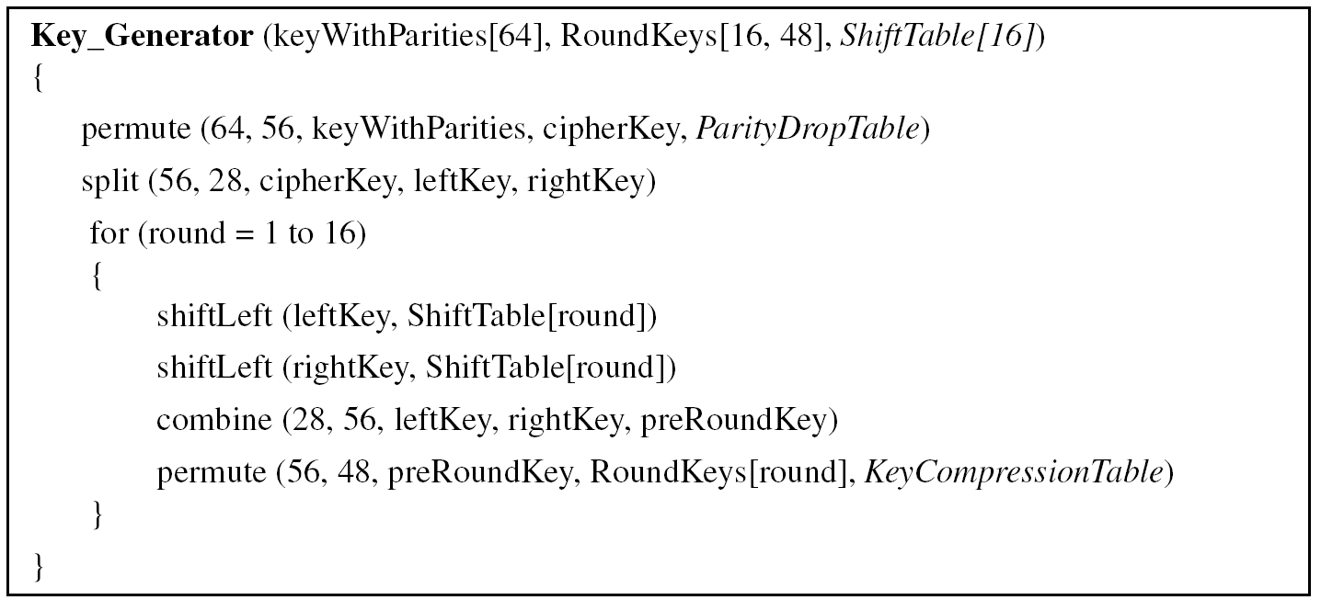
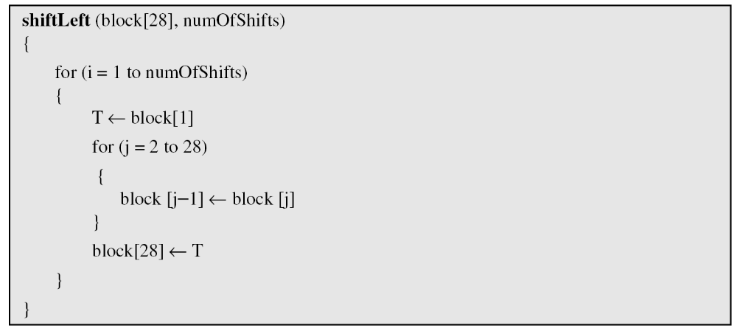
Algorithm for round-key generation
B C Dhara, Dept. of IT, JU

Slide 37
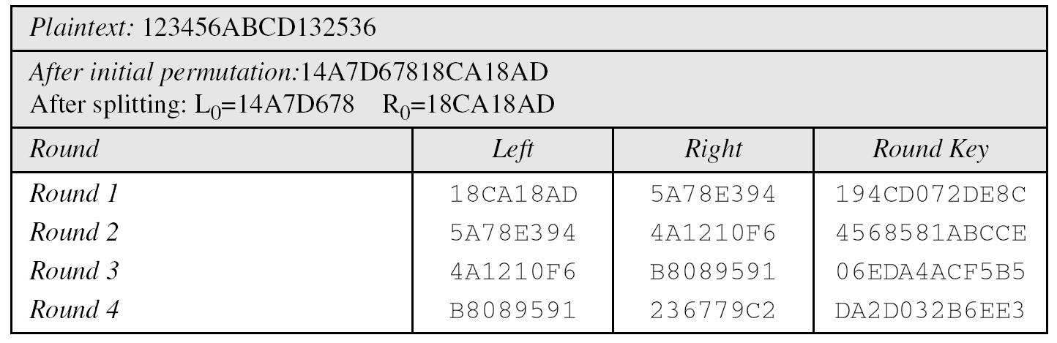
Example DES encipherment
We choose a random plaintext block and a random key, and determine what the ciphertext block would be (all in hexadecimal):
B C Dhara, Dept. of IT, JU

Slide 38
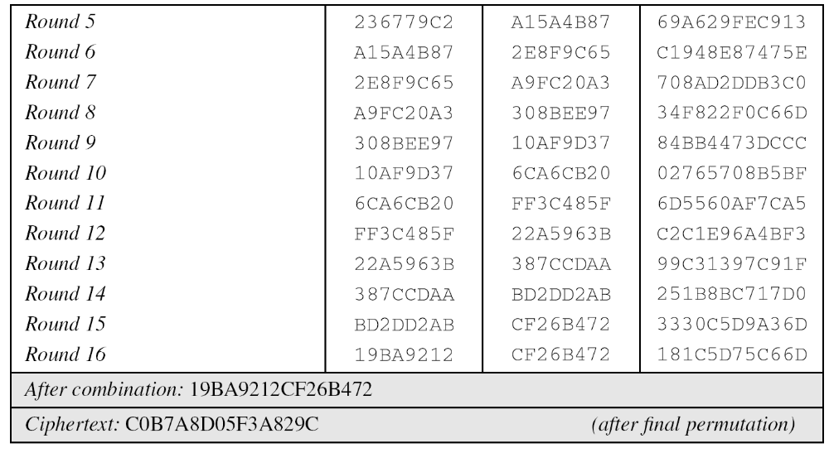
Example DES encipherment (contd…)
B C Dhara, Dept. of IT, JU

Slide 39
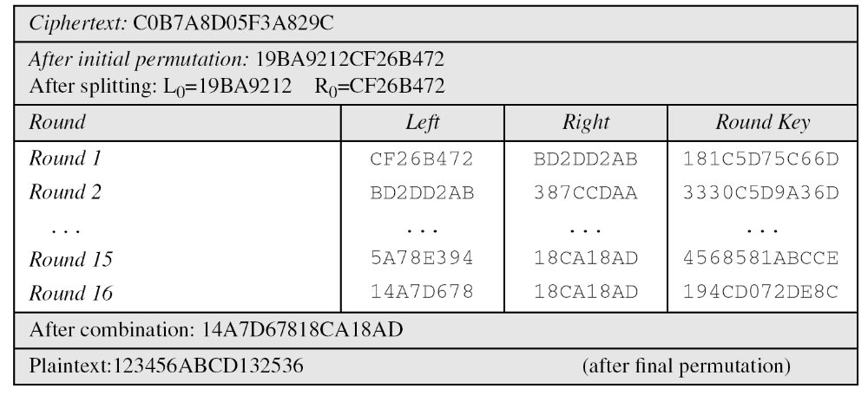
Example DES decipherment (contd…)
B C Dhara, Dept. of IT, JU

Slide 40
DES Analysis
Critics have used a strong magnifier to analyze DES
Tests have been done to measure the strength of some desired properties in a block cipher
  Properties
  Design Criteria
  DES Weaknesses
B C Dhara, Dept. of IT, JU

Slide 41
Properties
Two desired properties of a block cipher are
  the avalanche effect and
  the completeness
B C Dhara, Dept. of IT, JU

Slide 42
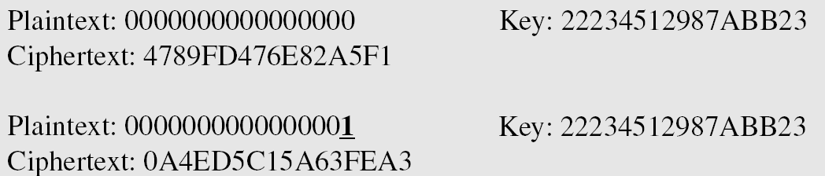
Avalanche effect
A small change in plaintext or key should create a significant change in ciphertext
In following example, we check the avalanche effect in DES
Two plaintext blocks (with the same key) that differ only in one bit and observe the result
B C Dhara, Dept. of IT, JU

Slide 43
Completeness effect
Completeness effect means that each bit of the ciphertext needs to depend on many bits on the plaintext
S-Boxes
  The design provides confusion and diffusion of bits from each round to the next
P-Boxes
  They provide diffusion of bits
Number of Rounds
  DES uses sixteen rounds of Feistel ciphers. the ciphertext is thoroughly a random function of plaintext and ciphertext.
B C Dhara, Dept. of IT, JU

Slide 44
DES Weaknesses
Weaknesses in S-boxes
  not covered as all the S-boxes are not included in this slide
Weaknesses in P-boxes
  Purpose of initial and final permutation is not clear, they also not provide any security benefit
  In expansion permutation, the first and fourth bits of every 4-bit series are repeated
Weaknesses in Key
B C Dhara, Dept. of IT, JU

Slide 45
Weaknesses in Key
Several weakness in the cipher key
  The size of the 56 bits
    With checking one million keys per second in a computer with single processor takes 2000 years for brute-force attack
    A computer with one million chips (parallel processing) takes 20 hours to test the whole key space
    …
  DES cipher with 56 bits key is not safe enough
B C Dhara, Dept. of IT, JU

Slide 46
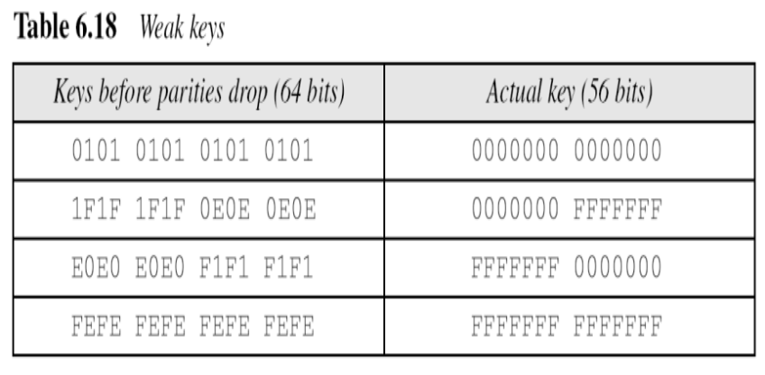
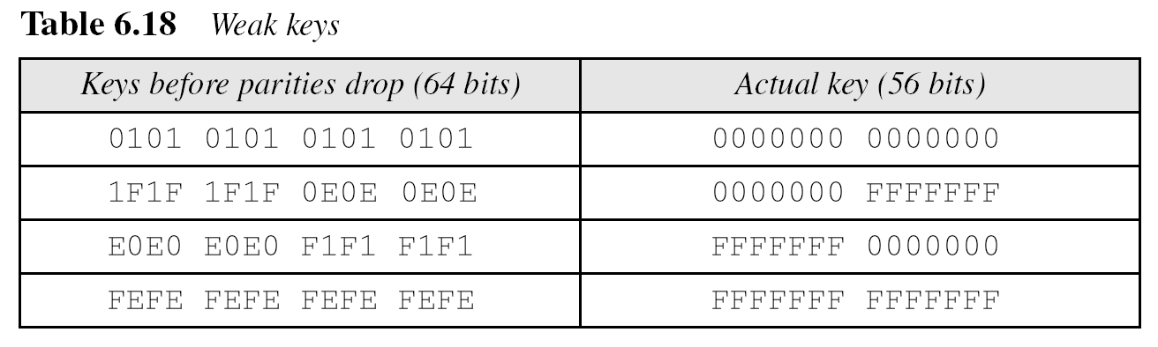
Weak keys
Four keys out of 2⁵⁶ keys are called weak keys
The round keys generated from the weak keys are same and have same pattern as the cipher key
  E.g., all sixteen round keys generated from first weak key is all mode of 0s
    As key-generation algorithm first divides the cipher key into two halves and shifting and permutation does not change the block at all
B C Dhara, Dept. of IT, JU

Slide 47
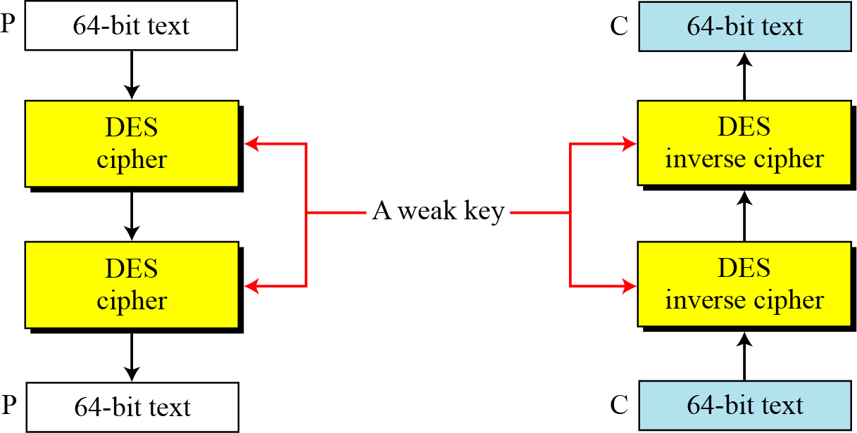
Weak keys (contd…)
Weak key is the inverse itself
B C Dhara, Dept. of IT, JU

Slide 48
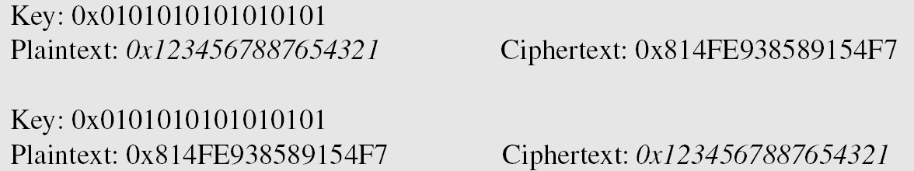
Weak keys (contd…)
Let us try the first weak key to encrypt a block two times
  After two encryptions with the same key the original plaintext block is created
  Note that we have used the encryption algorithm two times, not one encryption followed by another decryption.
B C Dhara, Dept. of IT, JU

Slide 49
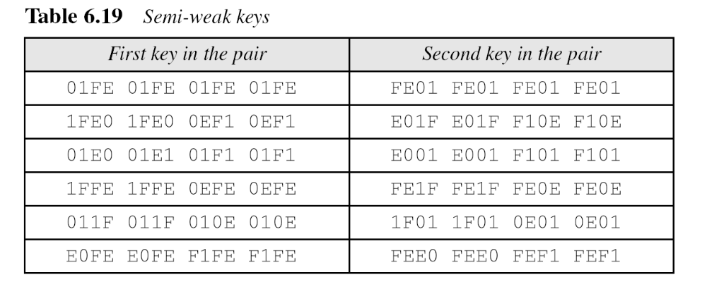
Semi-weak keys
There are six key pairs that are called semi-weak keys
  A semi-weak key creates two different round keys and each of them repeats eight times
  Round keys generated from each pair are the same with different orders
B C Dhara, Dept. of IT, JU

Slide 50
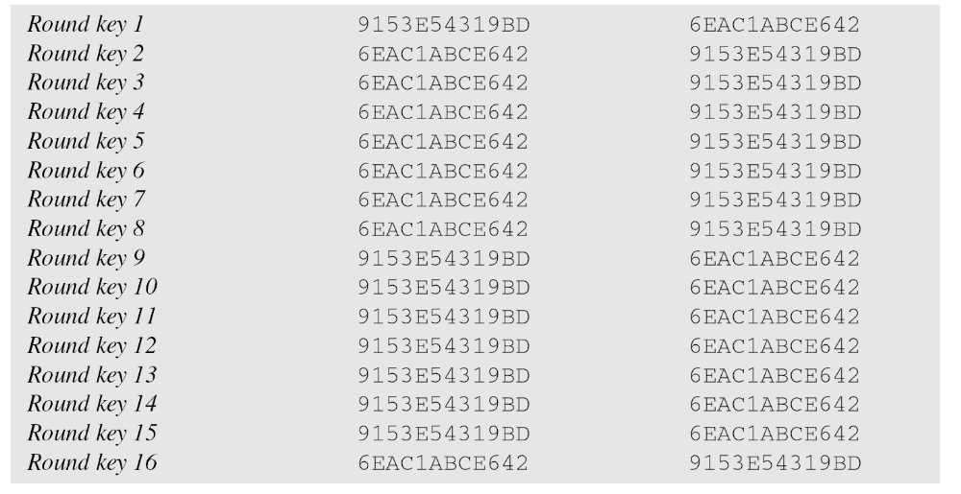
Round keys generated from semi-weak keys pair
Round key 1 in first set is the same as round key 16 in the second
Round key 2 in first set is the same as round key 15 in the second
and so on …
B C Dhara, Dept. of IT, JU

Slide 51
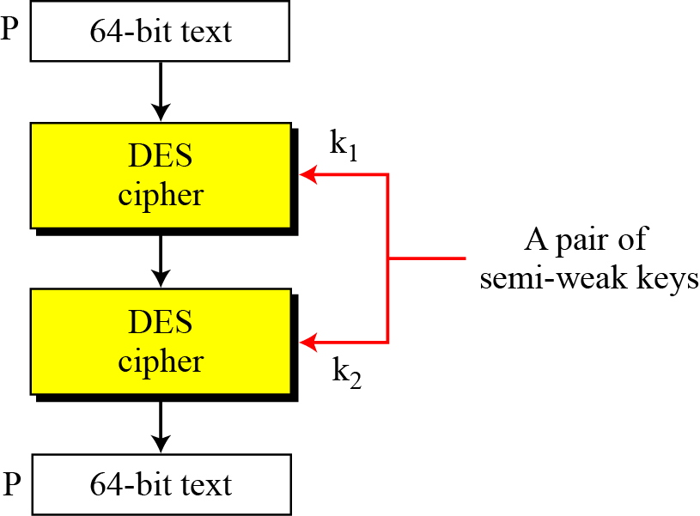
Semi-weak keys (contd…)
A pair of semi-weak keys in encryption and decryption
B C Dhara, Dept. of IT, JU

Slide 52
Possible weak keys
There are also 48 keys that are called possible weak keys
  A possible weak key generates only four distinct round keys
B C Dhara, Dept. of IT, JU

Slide 53
Key complement
A key complement is made by inverting each bit
It can be proved that C= E(K, P) → C’ = E(K’, P’)
  If the complement of the plaintext with the complement of the key is used to encrypt
    We get the complement of the ciphertext
  Attacker does not need to test all possible 2⁵⁶ possible keys
    She can test only half of them
B C Dhara, Dept. of IT, JU

Slide 54
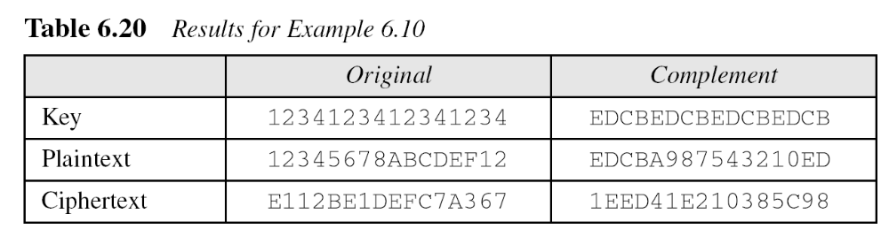
Key complement
Here one arbitrary key and plaintext are used to find the corresponding ciphertext
  If the key complement and the complement of plaintext, we can obtain the complement of the ciphertext
B C Dhara, Dept. of IT, JU

Slide 55
Multiple DES
The major drawback of DES is its key length
  With available technology, parallel processing a brute-force attack is feasible
  Abandon the DES and design a new cipher (AES)
  Use multiple instances of DES, no additional investment
Double DES
Triple DES
B C Dhara, Dept. of IT, JU

Slide 56
Multiple DES (contd…)
A substitution that maps every possible input to every possible output is a group.
If group: using two consecutive mappings is useless because we can always find third mapping that is equivalent to composition of the two
Using double DES with two keys k₁ and k₂ is useless as a single DES with k₃ does same thing
B C Dhara, Dept. of IT, JU

Slide 57
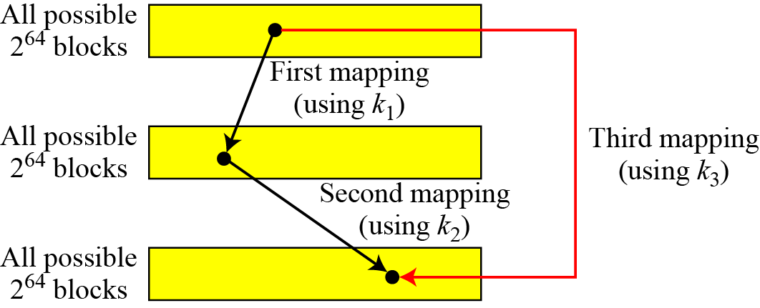
Composition mappings
using closure property of a group
B C Dhara, Dept. of IT, JU

Slide 58
Multiple DES (contd…)
Number of possible inpute or outputs in DES is N=2⁶⁴
Possible mappings is N! = 10^{347,380,000,000,000,000,000}
To support all of these mappings, key size should be log₂(2⁶⁴!)= 2⁷⁰ bits
DES key size is 56 bits
Non of the subset defined by 56 bits can form a group, DES is not a group
This means that we can use double or triple DES to increase the key size
B C Dhara, Dept. of IT, JU

Slide 59
Double DES (2DES)
Use two instances of DES ciphers for encryption with different keys
  Key size is doubled (i.e., 112 bits)
  2DES is vulnerable to known-plaintext attack
B C Dhara, Dept. of IT, JU

Slide 60
Meet-in-the-Middle Attack
It looks that 2DES increases the number of tests for key search from 2⁵⁶ to 2¹¹²
A known-plaintext attack, called, meet-in-the-middle attack proves that 2DES improves this vulnerability slightly (to 2⁵⁷ tests), but not tremendously (to 2¹¹²)
B C Dhara, Dept. of IT, JU

Slide 61
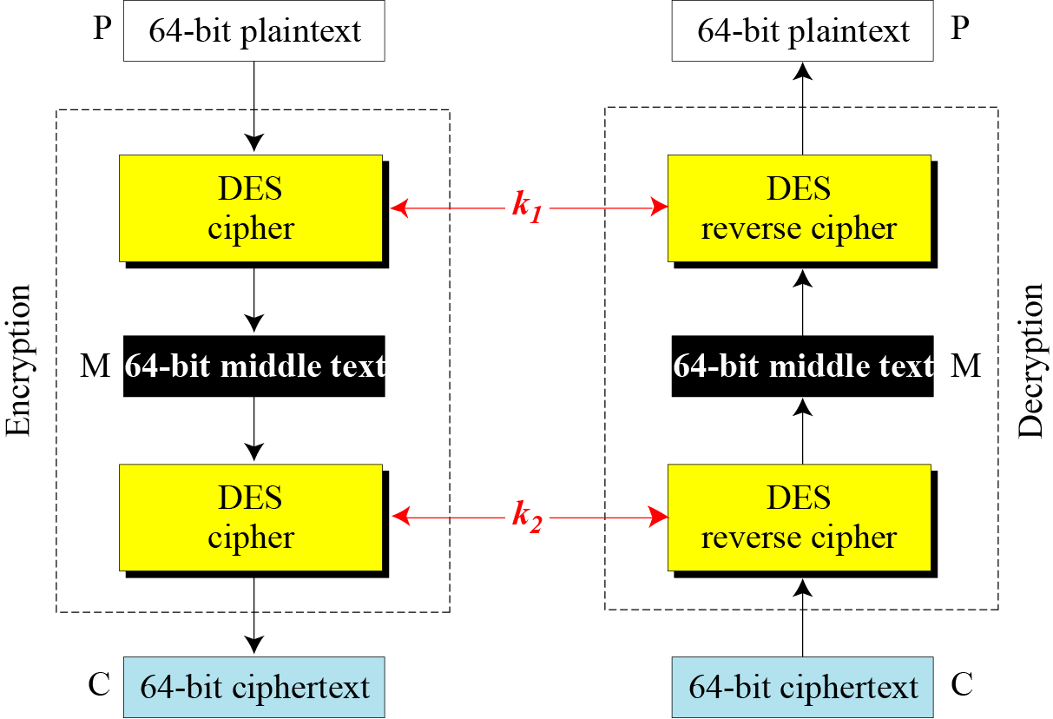
Meet-in-the-middle attack
B C Dhara, Dept. of IT, JU

Slide 62
Meet-in-the-middle attack (contd…)
For middle text M:
M= E(k₁, P) = D(k₂, C)
Attacker intercepted P and C
  Attacker use all possible keys and compute corresponding M1=E(P, k) and store in a table T1 (2⁵⁶ )
  Attacker use all possible keys and compute corresponding M2=D(C, k’) and store in a table T2 (2⁵⁶ )
B C Dhara, Dept. of IT, JU

Slide 63
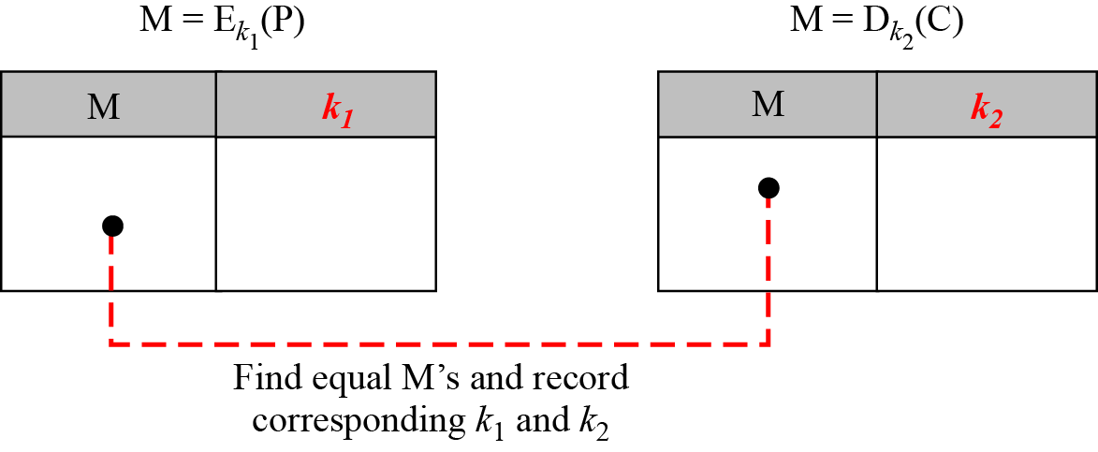
Meet-in-the-middle attack (contd…)
Match T1 and T2
  If unique match, so key pair (k₁, k₂) identified
  If multiple matches, consider the matched key pairs (number is very small)
    Consider second intercepted plaintext-ciphertext pair and repeat the above process only on the matched key pairs
Instead of 2¹¹² searches number of search will be limited by 2⁵⁷
B C Dhara, Dept. of IT, JU

Slide 64
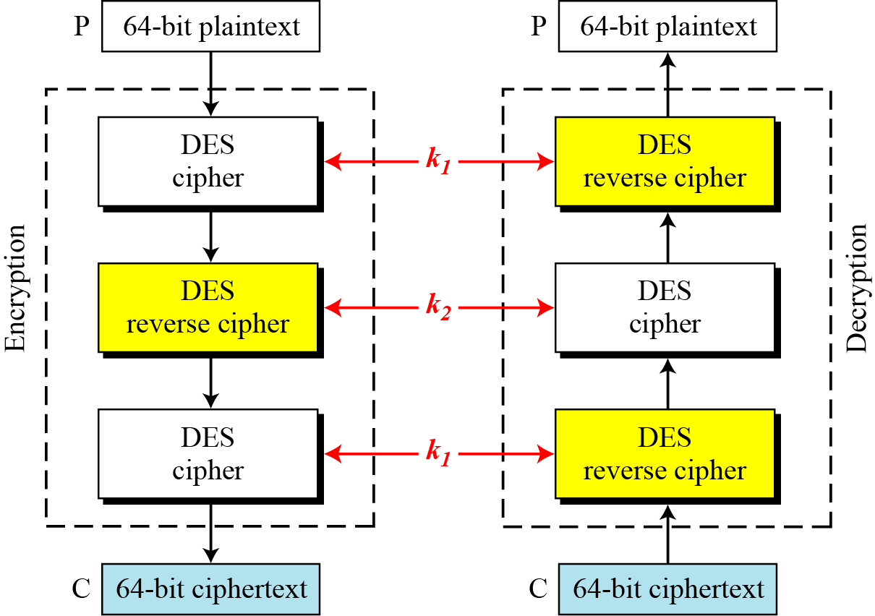
Triple DES
Two versions: With two keys, with three keys
B C Dhara, Dept. of IT, JU

Slide 65
Triple DES with Three Keys
The possibility of known-plaintext attacks on triple DES with two keys has enticed some applications to use triple DES with three keys
Triple DES with three keys is used by many applications such as PGP (See Chapter 16).
B C Dhara, Dept. of IT, JU

Slide 66
Security of DES
DES, as the first important block cipher, has gone through much scrutiny
Among the attempted attacks, three are of interest:
  brute-force,
  differential cryptanalysis, and
  linear cryptanalysis
B C Dhara, Dept. of IT, JU

Slide 67
Brute-Force Attack
We have discussed the weakness of short cipher key in DES. Combining this weakness with the key complement weakness, it is clear that DES can be broken using 2⁵⁵ encryptions.
3DES:
  with two keys: key size 2¹¹²
  with three keys: key size 2¹⁶⁸
  Make brute-force quite difficult
B C Dhara, Dept. of IT, JU

Slide 68
Differential Cryptanalysis
It has been revealed that the designers of DES already knew about this type of attack and designed S-boxes and chose 16 as the number of rounds to make DES specifically resistant to this type of attack
Using 2⁴⁷ chosen ciphertext or 2⁵⁵ known plaintext, DES can be broken
  Impractical to find such texts
B C Dhara, Dept. of IT, JU

Slide 69
Linear Cryptanalysis
Linear cryptanalysis is newer than differential cryptanalysis
DES is more vulnerable to linear cryptanalysis than to differential cryptanalysis
S-boxes are not very resistant to linear cryptanalysis
It has been shown that DES can be broken using 2⁴³ pairs of known plaintexts
  However, from the practical point of view, finding so many pairs is very unlikely.
B C Dhara, Dept. of IT, JU

